Slide 1











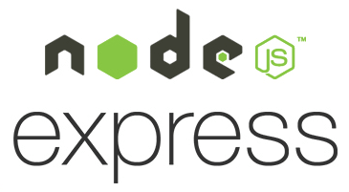













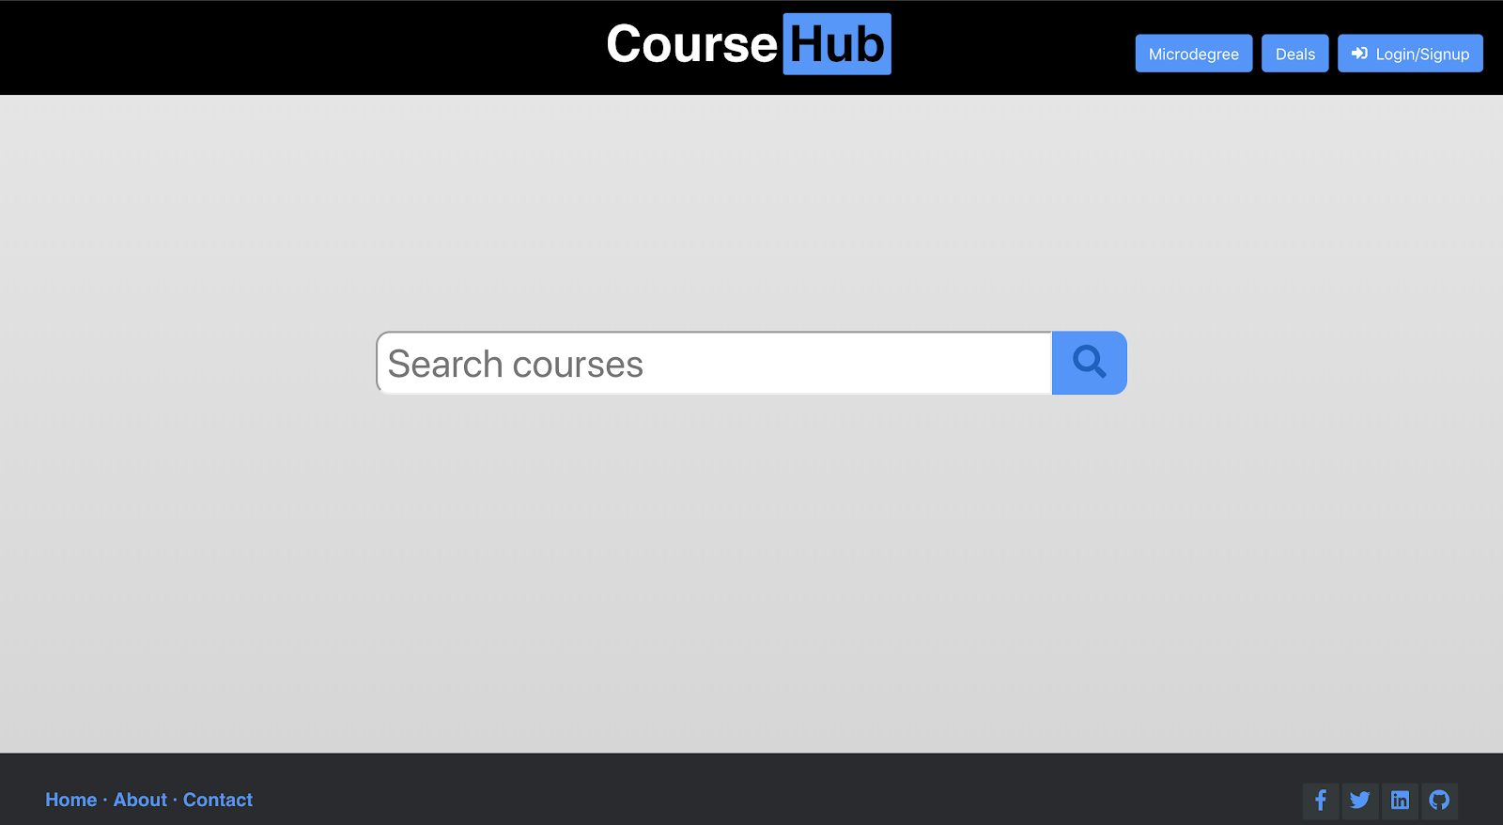
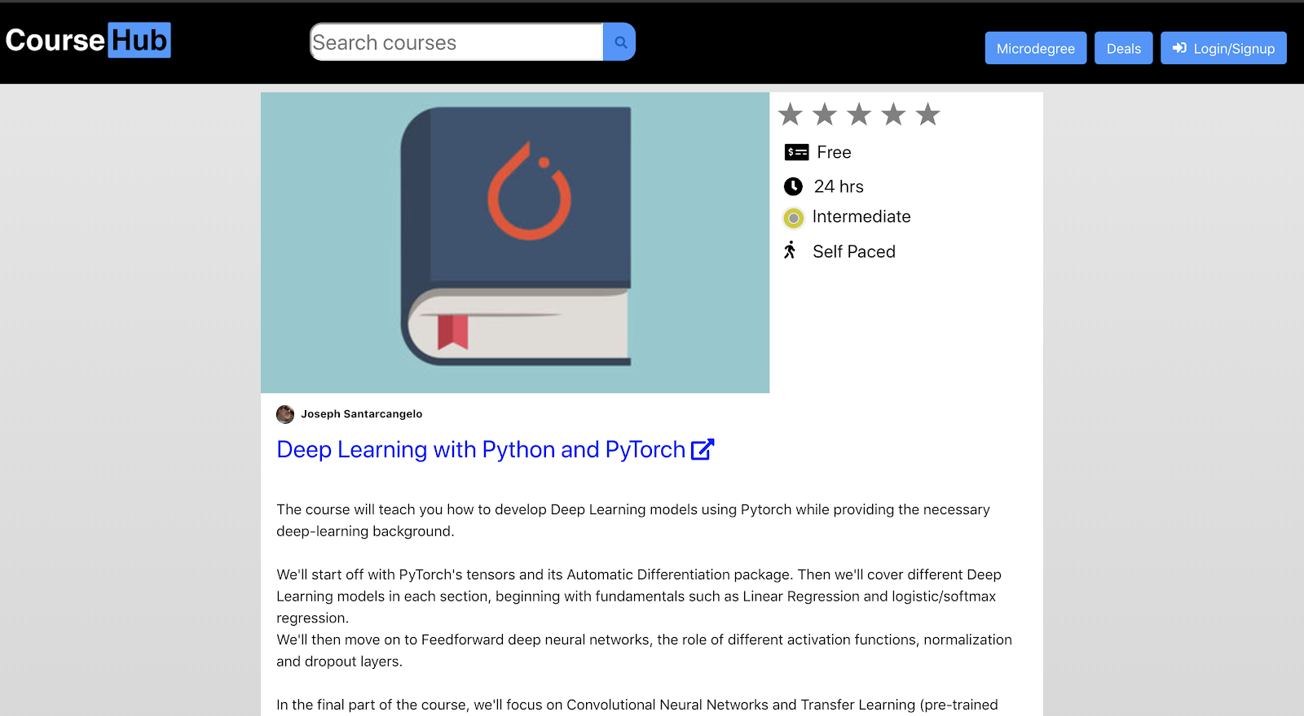

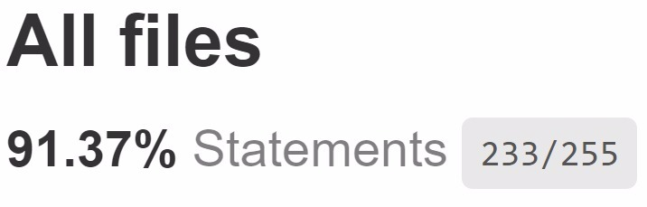

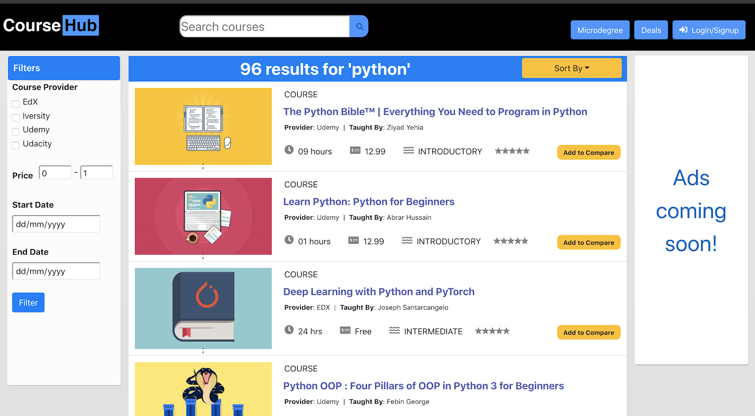
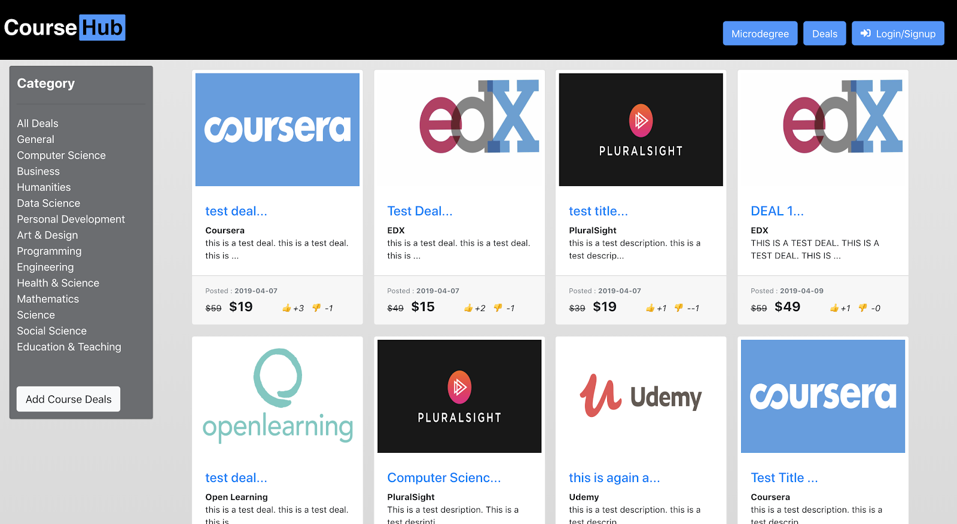

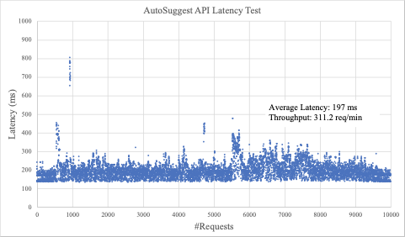
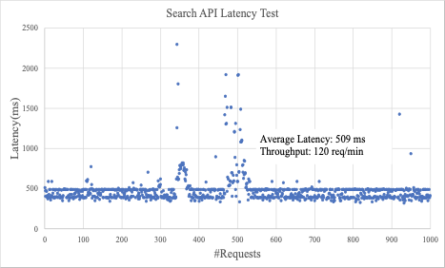
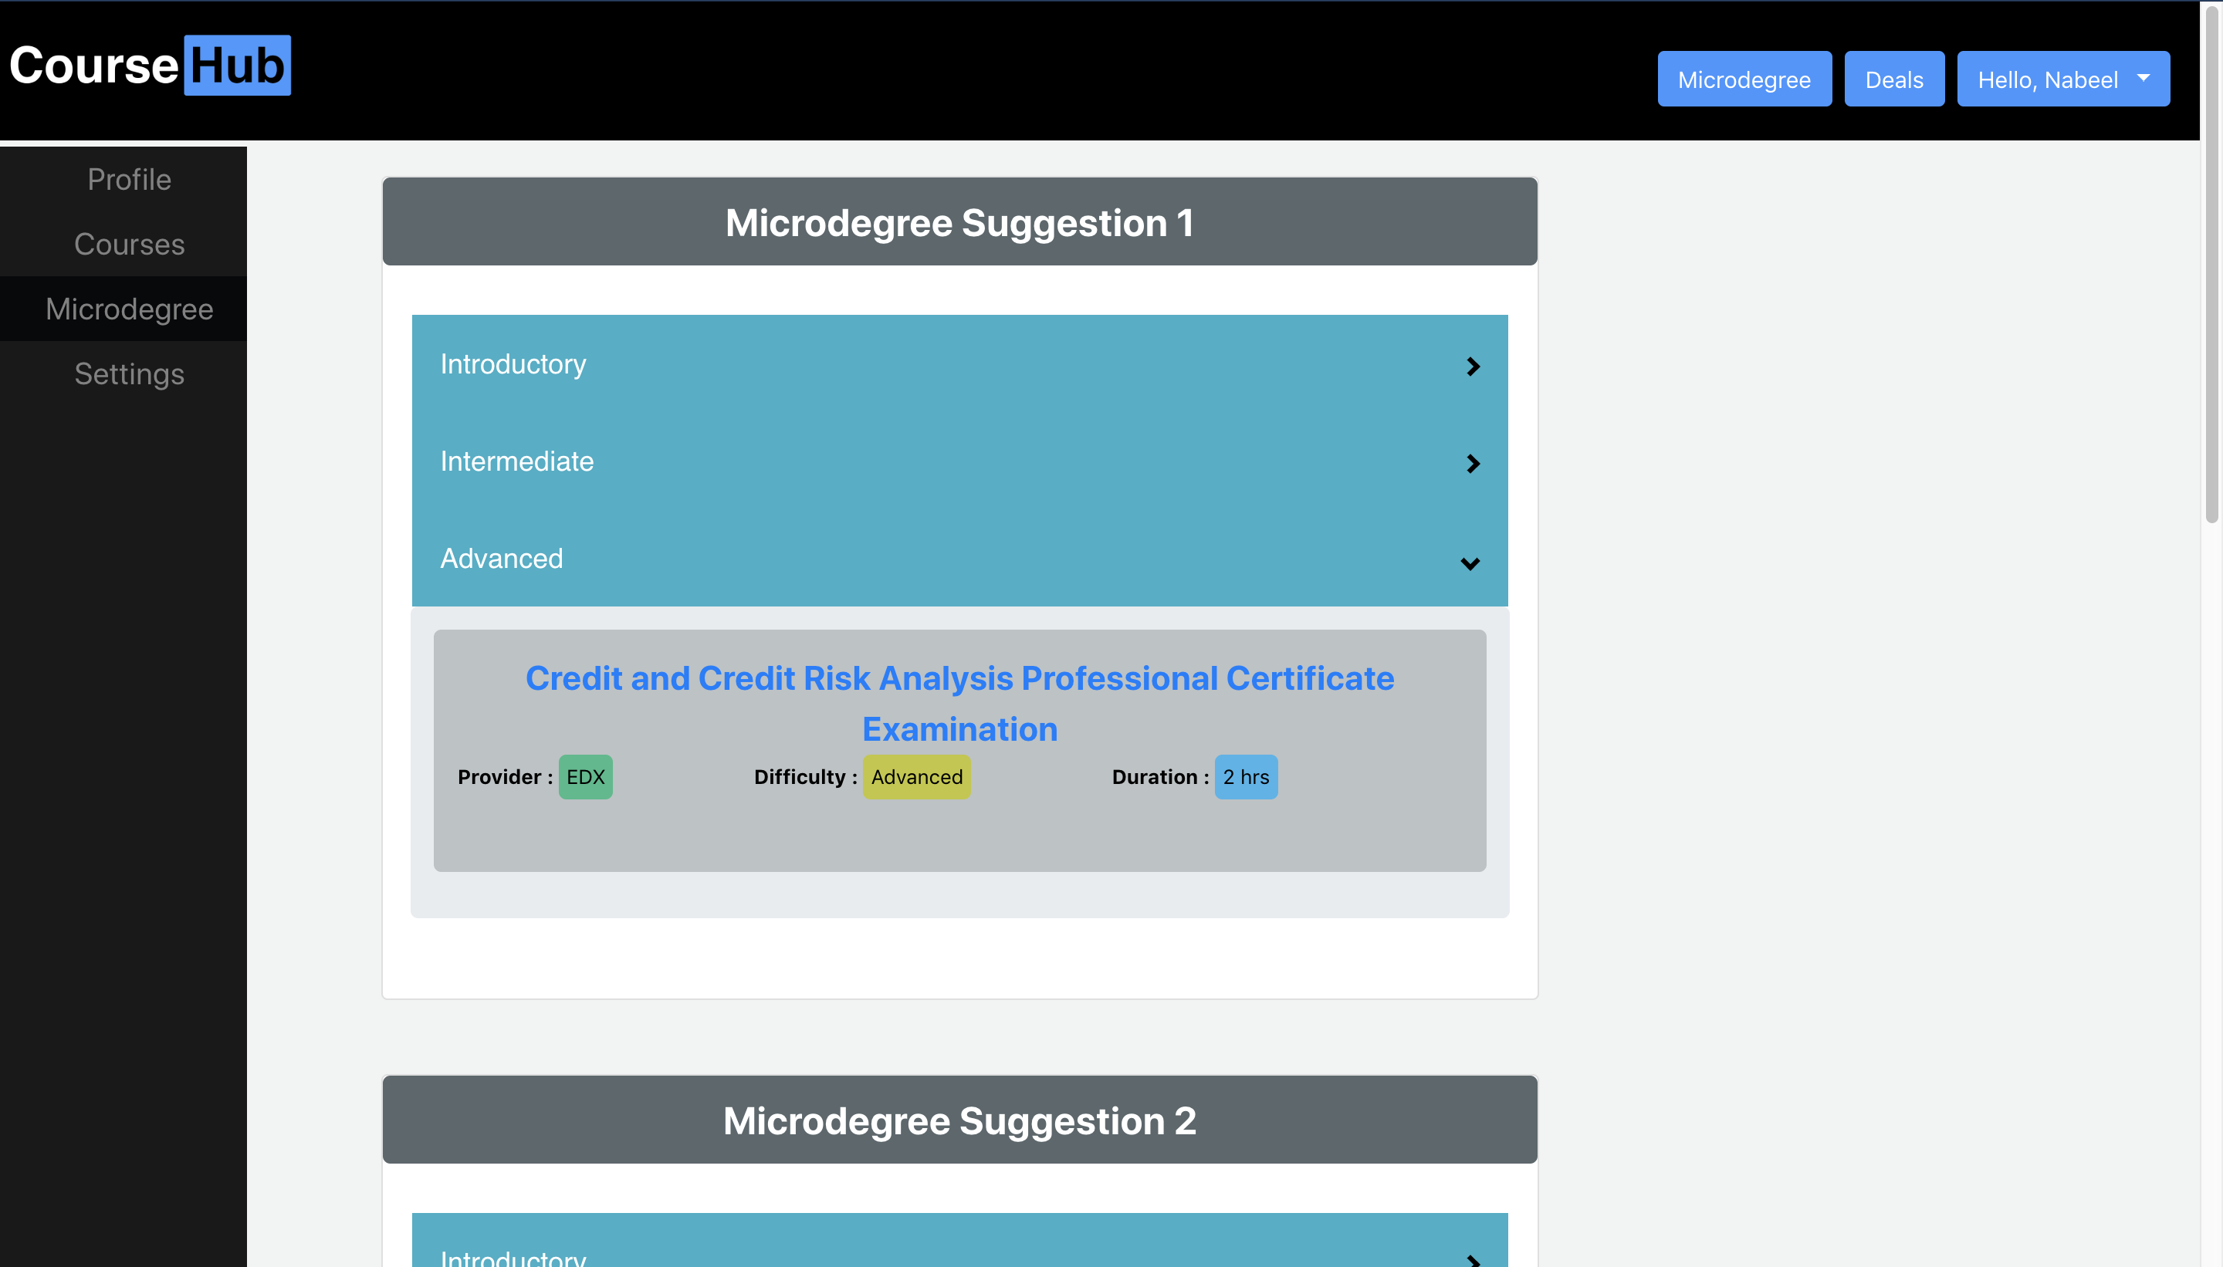
course-hub.com
Nabeel Khan, Indranil Guha, Abhijeet Kharkar & Ali Asger
Computer Science, The University of Iowa
Vision
Collaborating Course Providers
Sustainability
Course-Hub is a Website for Searching and Comparing Online Courses from multiple education portals. Course-Hub will allow users to view online courses from different education portals and sort and filter them based on user-rating, price, availability.
It will also have a functionality to recommend "Paths" for a "Micro-Degree" by combining courses from different portals.
Course-Hub will allow users to post course deals available on different portals similar to SlickDeals.
Targeting user’s of all age group who looks forward to Online Learning.
Advertisement based revenue model.
Microdegree Recommendation spanning across multiple online platforms for a single degree.
Many more collaborator’s to come in future.
Microservices based Architecture to create a mobile app in future.
Technologies
Architecture
Methodology
Services
Frontend
Backend
aws lambdas
Database
Elastic Search(aws)
Auth Service
Firebase
Infrastructure
Semaphore CI
Code Climate
Docker
Google Cloud
Kubernetes
Github is used for code base management
Agile Methodology is followed
Zenhub is used to create stories, task and track sprint progress
Pull Requests(PR) merged after at least 1 review
Product owner is responsible for merging PR
Each PR should have appropriate testing for the functionality.
Unit Testing
Functional & Load Testing
Snapshots
Jest & Enzyme
NodeJS and ReactJS
Python Unit Test
aws lambda
Code Coverage
Backend Coverage (91%)
Frontend Coverage (88%)
aws lambda Coverage (92%)
Code coverage tool: Istanbul
Overall code coverage: 89%
Functional Testing using Selenium
Number of scenarios covered : 26
Load Testing
Using Apache JMeter
Tested Backend API
Search and autosuggest APIs are tested

